Slide 1
Kinetic Theory of Gases and Radiation
Chapter-03

Slide 2

ideal gas equation
Boyle's law: V $α$ 1/P at constant T
Charles' law V $α$ T at constant P
Gay-Lussac's law: P $α$ T at constant V
All the three laws apply to fixed mass m of an enclosed gas
Combining the three laws, PV $α$ T or $\frac{P_{1}V_{1}}{T_{1}}$ = $\frac{P_{2}V_{2}}{T_{2}}$
three laws in terms of number of moles n of gas, PV $α$ nT or PV $=$ nRT (where n is number of moles of gas and proportionality constant R is the universal gas constant)
Alternatively, PV = N$k_{B}$T ( where N is number of molecules and $k_{B}$ Boltzmann constant)
For one mole of gas N=$N_{A}$ (Avogadro's number), PV = $N_{A}k_{B}$T
And R= $N_{A}k_{B}$
A gas obeying the equation of state PV = nRT at all pressures, and temperatures is an ideal gas

Slide 3

Behavior of a Gas
it is very difficult to understand the behavior of a gas in terms of motion of a single particle (molecule).
The number of particles in the gas is itself so large (~ ${10}^{23}$ particles per $m^{3}$) that any attempt to relate the macroscopic parameters P, V, T and E with the motion of individual particles would be useless.
Hence, certain assumptions are made regarding the particles (molecules) of a gas, averages of physical quantities over the large number of particles involved are obtained and these averages are finally related to the macroscopic parameters of the gas like pressure, temperature, volume etc.

Slide 4
Ideal Gas and Real Gas
In an ideal gas intermolecular interactions are absent
Real gases are composed of atoms or molecules which do interact with each other
If the atoms/ molecules of a real gas are so far apart that there is practically no interatomic/ intermolecular interaction, the real gas is said to be in the ideal state
This can happen at sufficiently low density of the real gas
At low pressures or high temperatures, the molecules are far apart and therefore molecular interactions are negligible
Under these conditions, behavior of real gases is close to that of an ideal gas

Slide 5
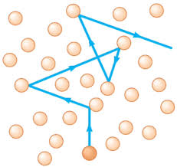

Mean Free Path
The molecules of gas are always in continuous random motion as shown in figure.
When a molecule approaches another molecule, This leads to elastic collisions between the molecules.
Due to this collision the direction of motion of the molecules change
The molecules also collide with the walls of the container and exert force only during collisions
Between two successive collisions, molecules move along straight paths with constant velocity
The average distance traversed by a molecule with constant velocity between two successive collisions is called mean free path ($ʎ$).

Slide 6

Pressure of Ideal Gas
we neglect intermolecular collisions and consider only elastic collisions with the walls
A typical molecule of mass m is shown in the Fig. 3.2 moving with the velocity v , about to collide with the shaded wall of the cube with length L.
As the collision is assumed to be elastic, during collision, the component Vx of the velocity will get reversed, keeping Vy and Vz components unaltered
Considering all the molecules, their average y and z components of the velocities are not changed by collisions with the shaded wall.
Hence the change in momentum of the particle is only in the x component of the momentum, $∆M_{x1}$ is given by
$∆M_{x1}$= = final momentum - initial momentum
= (-m$V_{x1}$) - (m$V_{x1}$) = - 2 m$V_{x1}$
Thus, the momentum transferred to the wall during collision is + 2m$V_{x}$
Vz
Vx
Vy

Slide 7

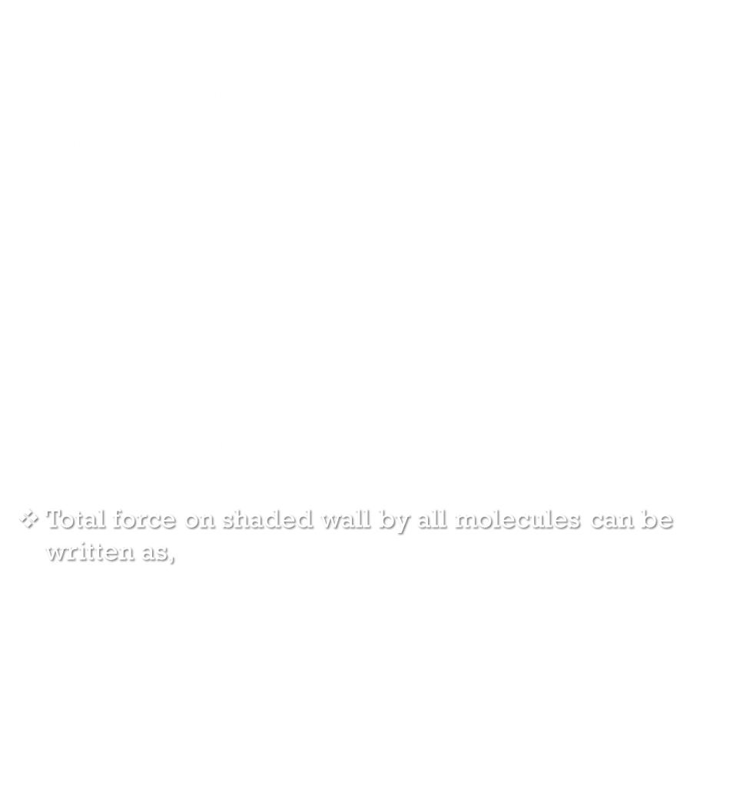
The bounce back molecule then goes to the opposite wall and collides with it and is reflected back, again collide with shaded wall.
This means that the molecule travels a distance of 2L in between two collisions
Hence to get the average force, we have to divide by the time between two successive collisions
Hance, time between 2 collision given by $∆t=\frac{2L}{V_{x1}}$
Average force on wall by 1 molecule = average rate of change of momentum.
$F_{x1}= \frac{∆M}{∆t}$ = $\frac{2mV_{x1}}{2L/V_{x1}}$ = $\frac{m{V_{x1}}^{2}}{L}$
Total force on shaded wall by all molecules can be written as,
$F_{x}=\frac{m({V_{x1}}^{2}+{V_{x2}}^{2}±−−−−{V_{xN}}^{2})}{L}$
Total pressure on shaded wall, $P_{x}=\frac{F_{x}}{Area of shaded wall}$ = $\frac{m({V_{x1}}^{2}+{V_{x2}}^{2}±−−−−{V_{xN}}^{2})}{L.L^{2}}$
= $\frac{m({V_{x1}}^{2}+{V_{x2}}^{2}±−−−−{V_{xN}}^{2})}{L^{3}}$
The average of the square of the x component of N molecule the velocities is given by
${\overline{V_{x}}}^{2}$=$\frac{({V_{x1}}^{2}+{V_{x2}}^{2}±−−−−{V_{xN}}^{2})}{N }$ $({V_{x1}}^{2}+{V_{x2}}^{2}±−−−−{V_{xn}}^{2})$= ${\overline{V_{x}}}^{2}$N
Hence, $P_{x}=$ $\frac{mN{\overline{V_{x}}}^{2}}{L^{3}}$
Now, ${\overline{V}}^{2}$= ${\overline{V_{x}}}^{2}$+${\overline{V_{y}}}^{2}$+${\overline{V_{z}}}^{2}$
By symmetry, ${\overline{V_{x}}}^{2}$=${\overline{V_{y}}}^{2}$=${\overline{V_{z}}}^{2}$= ${\overline{V}}^{2}/3$
$∴P_{x}= \frac{mN{\overline{V}}^{2}}{{3L}^{3}}$ = $\frac{mN{\overline{V}}^{2}}{3V}$
Since pressure exert on any wall is same, hence p = $\frac{1}{3} \frac{Nm}{V}$ ${\overline{V}}^{2}$

Slide 8
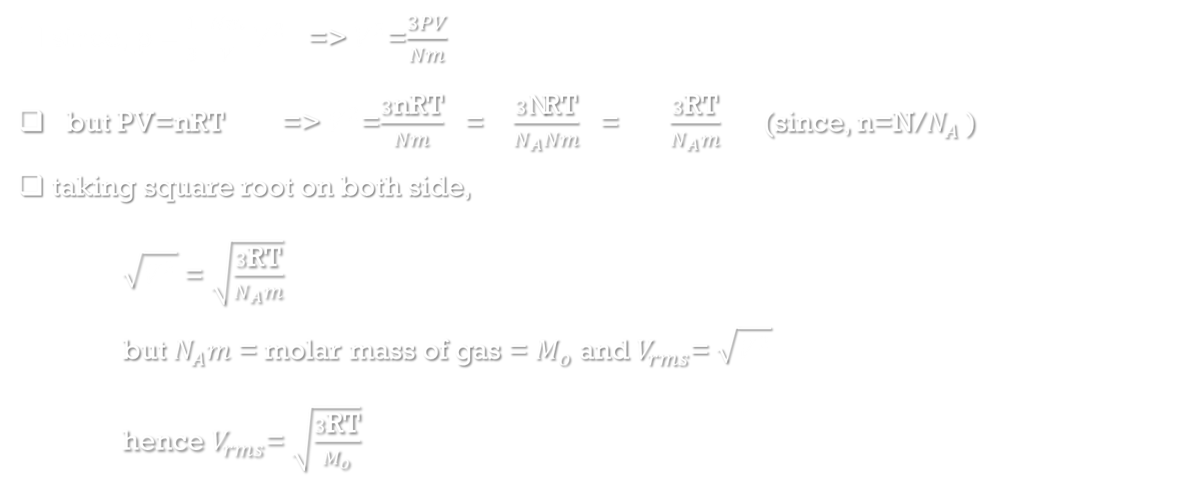
Root Mean Square (rms) Speed
since, p = $\frac{1}{3} \frac{Nm}{V}$ ${\overline{V}}^{2}$ => ${\overline{V}}^{2}$=$\frac{3PV}{Nm}$
but PV=nRT => ${\overline{V}}^{2}$=$\frac{3\text{nRT}}{Nm}$ = $\frac{3\text{N}\text{RT}}{N_{A}Nm}$ = $\frac{3\text{RT}}{N_{A}m}$ (since, n=N/$N_{A}$ )
taking square root on both side,
$\sqrt{{\overline{V}}^{2}}$ = $\sqrt{\frac{3\text{RT}}{N_{A}m}}$
but $N_{A}m$ = molar mass of gas = $M_{o}$ and $V_{rms}$= $\sqrt{{\overline{V}}^{2}}$
hence $V_{rms}$= $\sqrt{\frac{3\text{RT}}{M_{o}}}$

Slide 9
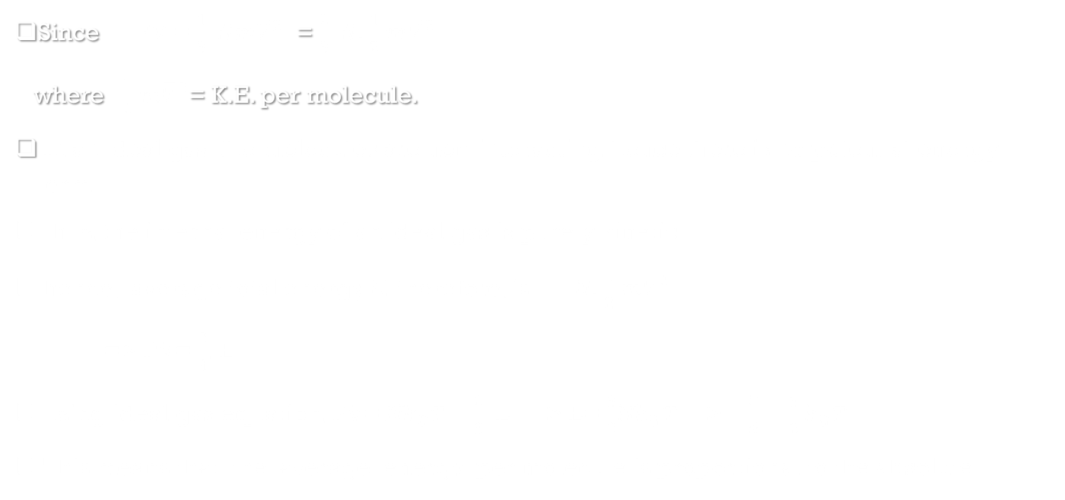
Interpretation of Temperature in Kinetic Theory
Since PV = $\frac{1}{3} Nm{\overline{V}}^{2}$ = $\frac{2}{3} N.$ $\frac{1}{2}$ $m{\overline{V}}^{2}$
where $\frac{1}{2}$ $m{\overline{V}}^{2}$= K.E. per molecule.
In an ideal gas, the molecules are non-interacting, hence there is no potential energy term
Thus, the internal energy of an ideal gas is purely kinetic
hence, average total energy E, therefore, is E= $N.$ $\frac{1}{2}$ $m{\overline{V}}^{2}$
=> PV= $\frac{2}{3}$. E
using ideal gas equation, PV= N$k_{B}$T = $\frac{2}{3}$. E => E= $\frac{3}{2}$N$k_{B}$T => $\frac{E}{N}$ = $\frac{3}{2}k_{B}$T
This means that the average energy per molecule is proportional to the absolute

Slide 10
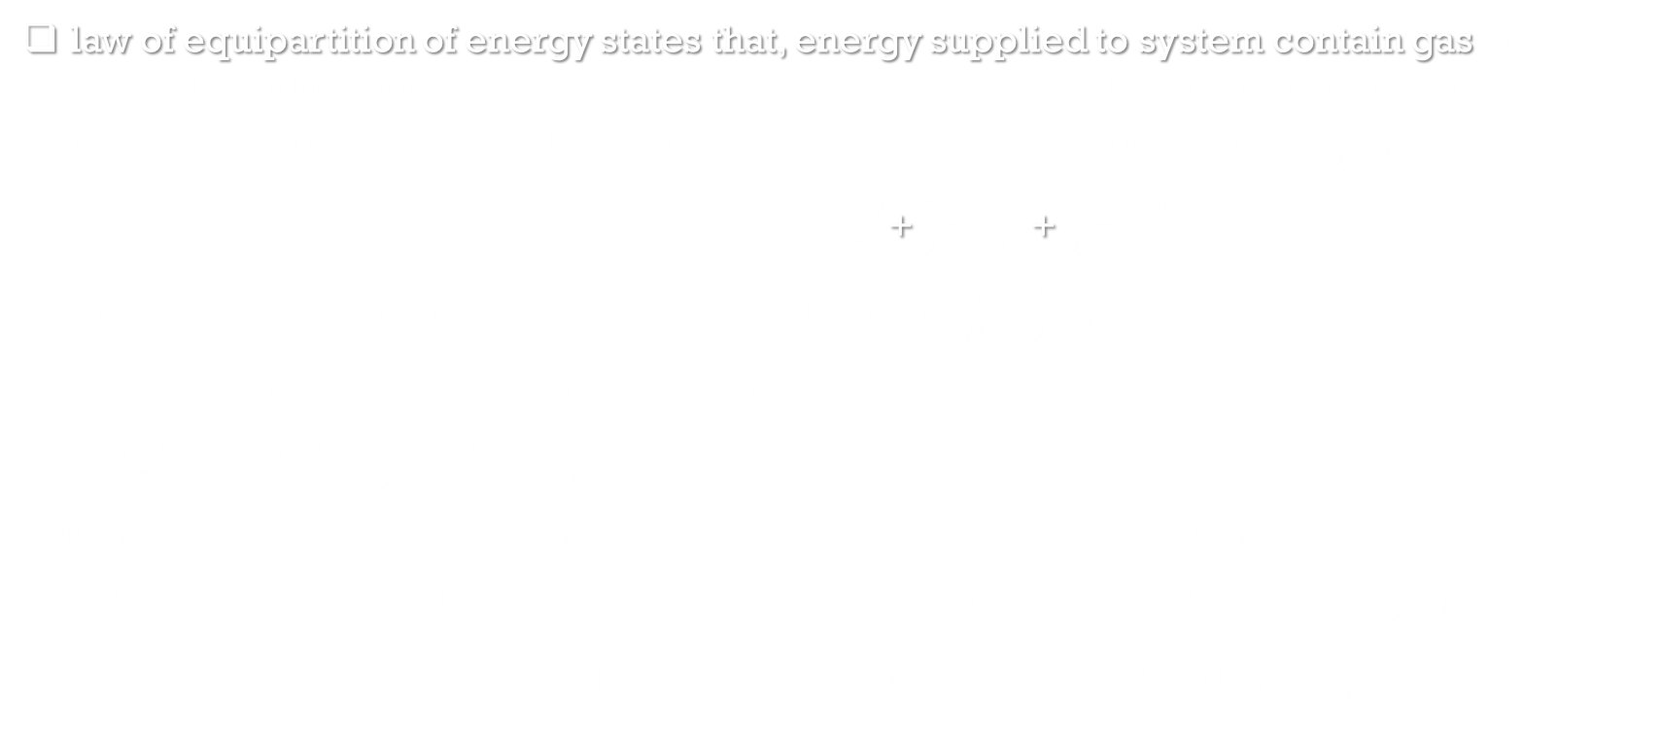
Law of Equipartition of Energy
law of equipartition of energy states that, energy supplied to system contain gas in thermal equilibrium, the total energy for the system is equally divided among the degree of freedom, energy acquire by each degree of freedom of a molecule is $\frac{1}{2}k_{B}$T
Since Average K.E. of a molecule is, K.E.= $\frac{1}{2}m{V_{x}}^{2}$+ $\frac{1}{2}m{V_{y}}^{2}$+ $\frac{1}{2}m{V_{z}}^{2}$
But we know that the mean energy per molecule is, $\frac{E}{N}$ = $\frac{3}{2}k_{B}$T
Since there is no preferred direction x or y or z,
$\frac{1}{2}m{V_{x}}^{2}=$ $\frac{1}{2}m{V_{y}}^{2}=$ $\frac{1}{2}m{V_{z}}^{2}$= $\frac{1}{2}k_{B}$T
Thus the mean energy associated with every component of translational kinetic energy which is quadratic in the velocity components in x, y and z directions is $\frac{1}{2}k_{B}$T
therefore the total translational energy contribution of the molecule is $\frac{3}{2}k_{B}$T

Slide 11
Degrees of Freedom
Degrees of freedom of a system are defined as the total number of coordinates or independent quantities required to describe the position and configuration of the system completely.
Eg. If a molecule is in translational motion that describe with 3 coordinates and their respective physical quantities can be resolve in 3 components hence, a molecule have 3 degree of freedom.

Slide 12
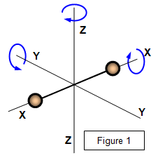
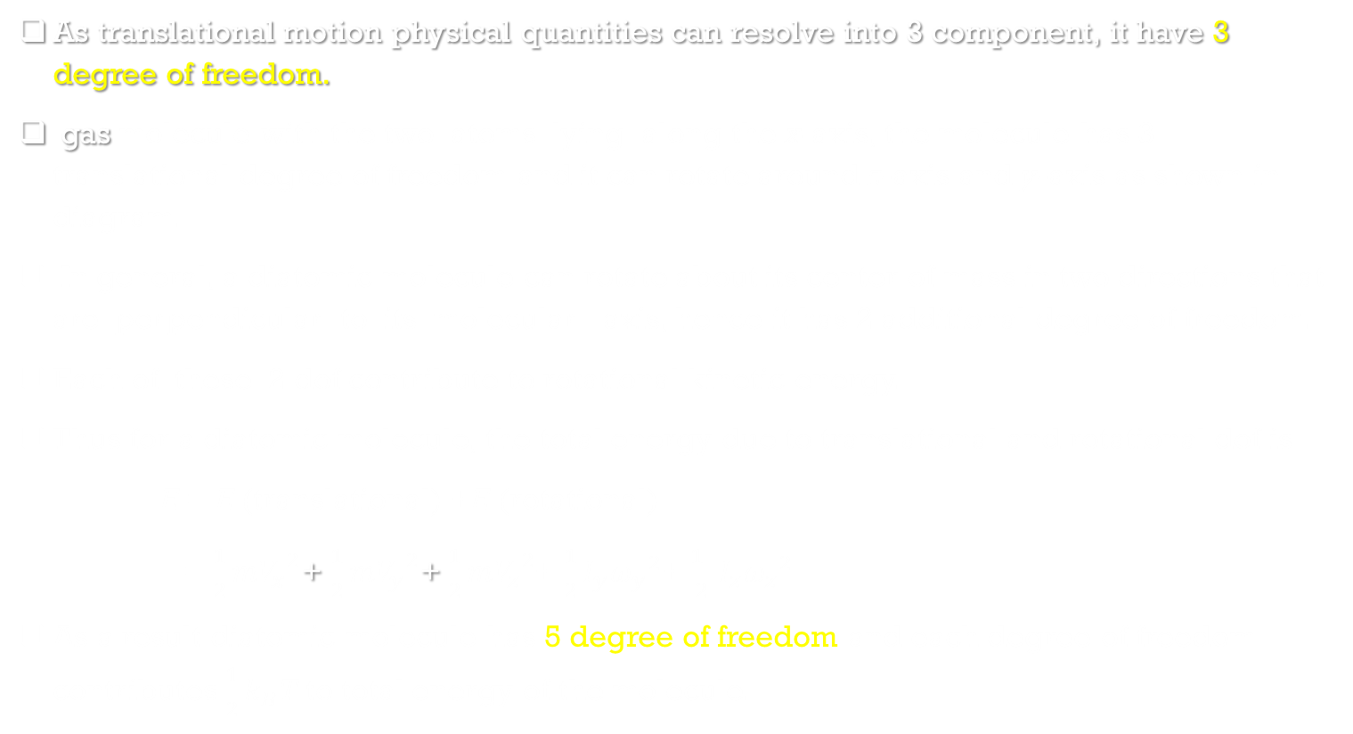
Degrees of Freedom of Monatomic and diatomic Gas molecule
As translational motion physical quantities can resolve into 3 component, it have 3 degree of freedom.
gas molecule with the two atoms lying along the x-axis, the molecule has 3 translational degree of freedom and it can rotate around z-axis and y-axis as shown in diagram.
In general, a diatomic molecule can rotate about its center of mass in two directions that are perpendicular to its molecular axis, hence it has 2 additional degree of freedom.
Each of these 2 dof contribute to rotational kinetic energy.
Thus for a diatomic molecule, the total energy due to translational and rotational dof is
E = E (translational) +E (rotational)
= $\frac{1}{2}m{V_{x}}^{2}$+ $\frac{1}{2}m{V_{y}}^{2}$+ $\frac{1}{2}m{V_{z}}^{2}$+ $\frac{1}{2}I_{y}{ω_{y}}^{2}$+ $\frac{1 }{2}I_{z}{ω_{z}}^{2}$
As a result diatomic molecule has 5 degree of freedom and each degree of freedom contributes $\frac{1}{2}k_{B}$T to total energy of the molecule.

Slide 13

Degrees of Freedom of non rigid diatomic Gas molecule
Real molecules contain covalent bonds between the atoms and therefore can perform additional motion namely vibrations of atoms about their mean positions.
Therefore possess additional dof corresponding to the different modes of vibration
In diatomic molecules like O2, N2 and CO, the atoms can oscillate along the internuclear axis only.
E = E (translational) +E (rotational)+ E (vibrational)
The term E (vibrational) consists of two contributions, kinetic energy and potential energy
E (vibrational) = $\frac{1}{2} m u^{2}$+ $\frac{1}{2} k r^{2}$
Thus each mode or dof for vibrational motion contributes 2 $×\frac{1}{2}k_{B}$T to the total internal energy.
Hence, diatomic non rigid molecule has 7 degree of freedom.

Slide 14

Specific Heat Capacity
The quantity of heat required to raise the temperature of 1 mole of the gas by 1 K, is called specific heat capacity.
The quantity of heat required to raise the temperature of 1 kg of the gas by 1 K, is called principal specific heat capacity
when the temperature of a gas is increased, even a small rise causes considerable change in volume and pressure. Therefore two specific heats are defined for gases, namely specific heat at constant volume $C_{v}$ and specific heat at constant pressure $C_{p}$

Slide 15


Mayer’s Relation
$∴$ ${ \text{dQ}}_{2}$= dE + dW= $C_{p}$ dT
but dE= $C_{v}$ dT
$∴$ $C_{v}$ dT+ dW= $C_{p}$ dT
$∴$ dW= $C_{p}$ dT - $C_{v}$ dT
$∴$ P dV= ($C_{p}$ - $C_{v}$ ) dT
For one mole of gas, PV = RT => p dV = R dT
$∴$R dT = ($C_{p}$ - $C_{v}$ ) dT
$∴ C_{p}$ - $C_{v}$ = R
This is known as Mayer’s relation between $C_{p}$ and $C_{v}$
When heat supplied measured in calories, $∴C_{p}$ - $C_{v}$ = R/J (where J is mechanical equivalent heat.)
Mayer’s relation with principal specific heat $C_{p}$=$M_{o}S_{p}$ and $C_{v}$=$M_{o}S_{v}$
$M_{o}S_{p}$- $M_{o}S_{v}$= R/J => $S_{p}$- $S_{v}$= $\frac{R}{M_{o}J}$
Consider one mole of an ideal gas that is enclosed in a cylinder by light, frictionless airtight piston with pressure P, volume V and temperature T.
If the gas is heated so that its temperature rises by dT, but the volume remains constant, then the amount of heat supplied to the gas${ \text{dQ}}_{1}$, is used to increase the internal energy of the gas (dE)
Since, volume of the gas is constant, no work is done in moving the piston.
$∴$ ${ \text{dQ}}_{1}$= dE= $C_{v}$ dT
if the gas is heated to the same temperature, at constant pressure, volume of the gas increases by an amount say dV.
The amount of heat supplied to the gas is used to increase the internal energy of the gas as well as to move the piston backwards to allow expansion of gas

Slide 16
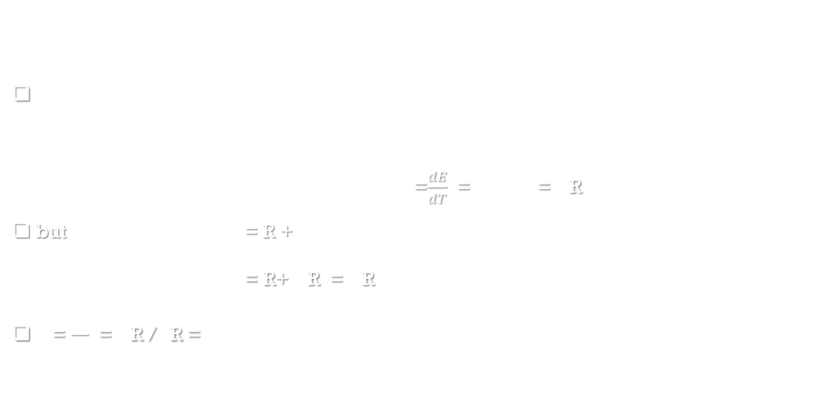
Ratio of specific heat $(γ)$ of Monatomic Gases
For a monatomic gas enclosed in a container, held at a constant temperature T and containing $N_{A}$ atoms, each atom has only 3 translational dof.
Therefore, average energy per atom is E = $\frac{3}{2}k_{B}$T and internal energy per mole is E = $\frac{3}{2}N_{A}k_{B}$T
Molar specific heat at constant volume $C_{v}$=$\frac{dE}{dT}$ = $\frac{3}{2}N_{A}k_{B}$ = $\frac{3}{2}$ R
but $C_{p}$ - $C_{v}$ = R => $C_{p}$= R + $C_{v}$
= R+ $\frac{3}{2}$ R = $\frac{5}{2}$ R
$γ$= $\frac{C_{p}}{C_{v}}$ = $\frac{5}{2}$ R /$\frac{3}{2}$ R = $\frac{5}{3}$

Slide 17
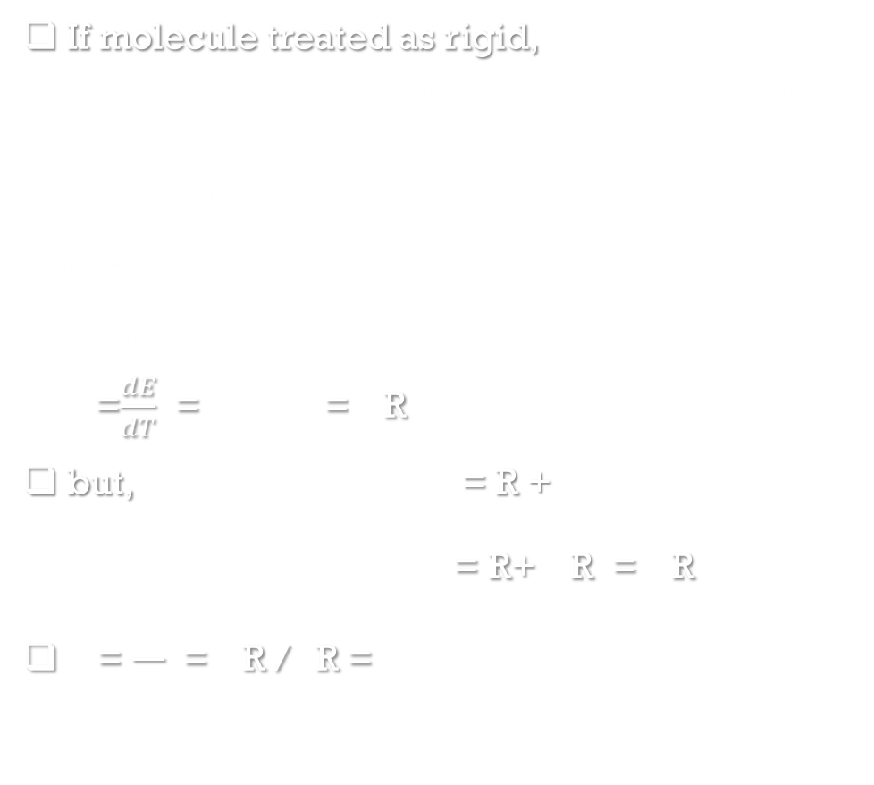
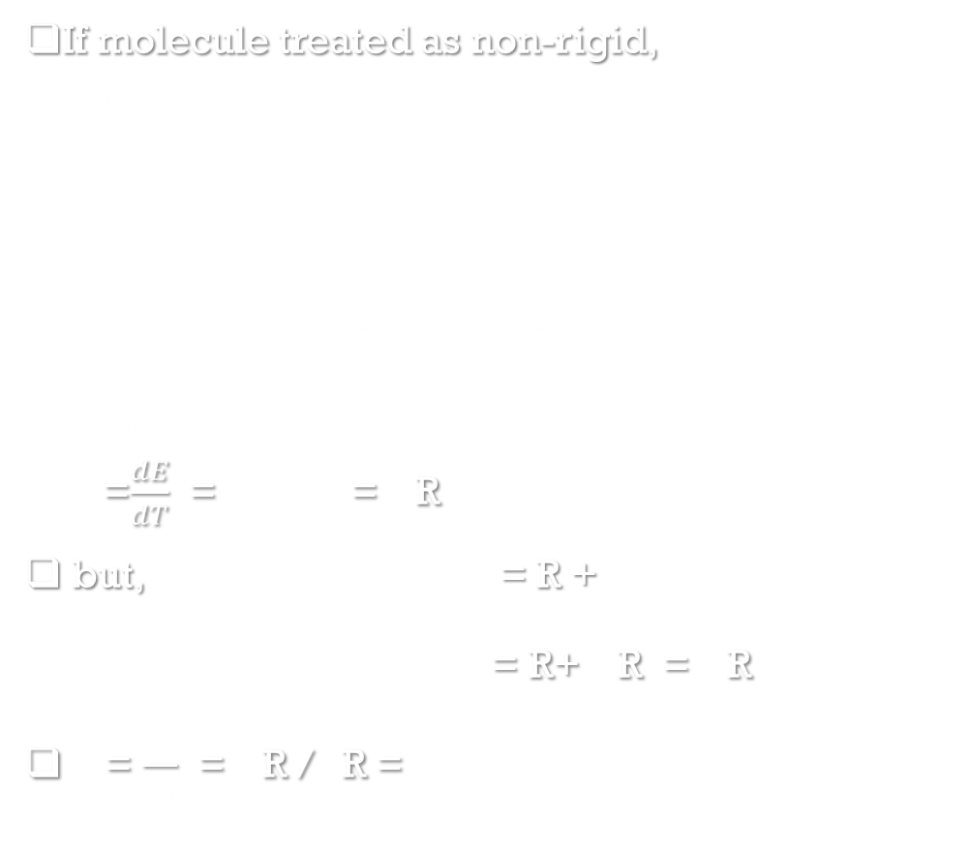
Ratio of specific heat $(γ)$ of Diatomic Gases
If molecule treated as rigid, each molecule will have 3 translational and 2 rotational dof.
According to the law of equipartition of energy, the internal energy of one mole of gas is, E = $\frac{3}{2}N_{A}k_{B}$T+ $\frac{2}{2}N_{A}k_{B}$T = $\frac{5}{2}N_{A}k_{B}$T
Molar specific heat at constant volume, $C_{v}$=$\frac{dE}{dT}$ = $\frac{5}{2}N_{A}k_{B}$ = $\frac{5}{2}$ R
but, $C_{p}$ - $C_{v}$ = R => $C_{p}$= R + $C_{v}$
= R+ $\frac{5}{2}$ R = $\frac{7}{2}$ R
$γ$= $\frac{C_{p}}{C_{v}}$ = $\frac{7}{2}$ R /$\frac{5}{2}$ R = $\frac{7}{5}$
If molecule treated as non-rigid, each molecule will have 3 translational and 2 rotational and 1 dof.
According to the law of equipartition of energy, the internal energy of one mole of gas is, E = $\frac{3}{2}N_{A}k_{B}$T+ $\frac{2}{2}N_{A}k_{B}$T+ $\frac{2}{2}N_{A}k_{B}$T = $\frac{7}{2}N_{A}k_{B}$T
Molar specific heat at constant volume, $C_{v}$=$\frac{dE}{dT}$ = $\frac{7}{2}N_{A}k_{B}$ = $\frac{7}{2}$ R
but, $C_{p}$ - $C_{v}$ = R => $C_{p}$= R + $C_{v}$
= R+ $\frac{9}{2}$ R = $\frac{9}{2}$ R
$γ$= $\frac{C_{p}}{C_{v}}$ = $\frac{9}{2}$ R /$\frac{7}{2}$ R = $\frac{9}{7}$

Slide 18
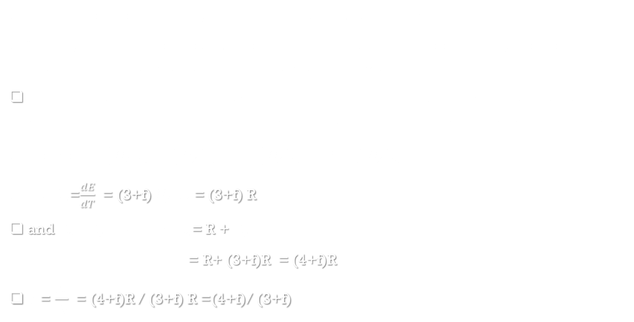
Ratio of specific heat $(γ)$ of Diatomic Gases
Each molecule of the polyatomic gas has 3 translational dof.
All polyatomic molecules can perform rotations about three mutually perpendicular axes through their center of mass, hence they have 3 dof for rotation.
The number of dof, f, for the vibrational motion of a polyatomic molecule depends on the geometric structure of the molecule and each vibrational motion have 2 dof.
hence, E = $\frac{3}{2}N_{A}k_{B}$T+ $\frac{3}{2}N_{A}k_{B}$T + f . $\frac{2}{2}N_{A}k_{B}$T = (3+f) $N_{A}k_{B}$T
but $C_{v}$=$\frac{dE}{dT}$ = (3+f) $N_{A}k_{B}$ = (3+f) R
and $C_{p}$ - $C_{v}$ = R => $C_{p}$= R + $C_{v}$
= R+ (3+f)R = (4+f)R
$γ$= $\frac{C_{p}}{C_{v}}$ = (4+f)R / (3+f) R =(4+f)/ (3+f)

Slide 19
Absorption, Reflection and Transmission of Heat Radiation
When heat radiation incident on the surface of material, part of heat absorbed by the material, which cause increment in internal energy of material, called absorption.
Part of heat reflected from the surface of material on which radiation incident, is called reflection.
Part of heat transferred through the material from one point to other point is called transmission.

Slide 20

Interaction of Thermal Radiation and Matter
Whenever thermal radiation falls on the surface of an object, some part of heat energy is reflected, some part is absorbed and the remaining part is transmitted.
Let Q be the total amount of thermal energy incident on the surface of an object and Qa, Qr and Qt be the respective amounts of heat absorbed, reflected and transmitted by the object
Q=Qa+Qr+Qt => 1=$\frac{Q_{a}}{Q}+\frac{Q_{r}}{Q}$+$\frac{Q_{t}}{Q}$
1 = a+r+t ( where a= $\frac{Q_{a}}{Q}$ , r= $\frac{Q_{r}}{Q}$ , t= $\frac{Q_{t}}{Q}$ )
Coefficient of absorption or absorptive power or absorptivity (a): The ratio of amount of heat absorbed to total quantity of heat incident is called the coefficient of absorption.
Coefficient of reflection or reflectance (r): The ratio of amount of radiant energy reflected to the total energy incident is called the coefficient of reflection
Coefficient of transmission or transmittance(t): The ratio of amount of radiant energy transmitted to total energy incident is called the coefficient of transmission
Since all the three quantities a, r and t are ratios of thermal energies, they are dimensionless quantities

Slide 21
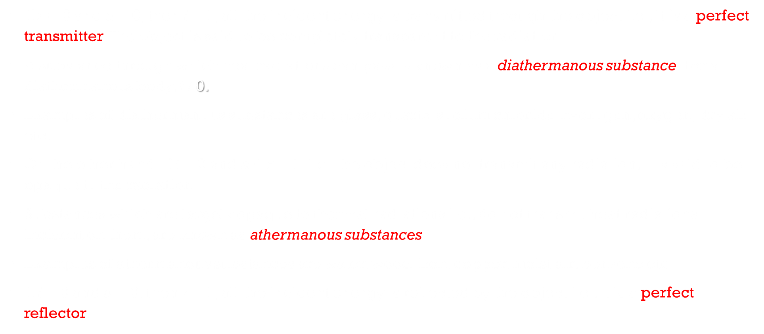
perfect transmitter, diathermanous substance and athermanous substances
If r = 0 and a = 0, then t = 1, all the incident energy is transmitted through the object i.e., it is a perfect transmitter. The object is said to be completely transparent to the radiation.
A substance through which heat radiations can pass is known as a diathermanous substance. For a diathermanous body, t$≠$0.
Examples of diathermanous substances are glass, quartz, sodium chloride, hydrogen, oxygen, dry air etc.
On the other hand, if t = 0 and a + r = 1, i.e., the object does not transmit any radiation, it is said to be opaque to the radiation
Substances which are largely opaque to thermal radiations i.e., do not transmit heat radiations incident on them, are known as athermanous substances.
Examples of athermanous substances are water, wood, iron, copper, moist air, benzene etc.
If t = 0 and a = 0, then r = 1, all the incident energy is reflected by the object i.e., it is a perfect reflector.

Slide 22
perfect blackbody
A body, which absorbs the entire radiant energy incident on it, is called an ideal or perfect blackbody.
Thus, for a perfect blackbody, a = 1. Any surface that absorbs all the energy incident on it, and does not reflect any energy, therefore, appears black (unless its temperature is very high to be self-luminous).
Lamp black or platinum black that absorb nearly 97% of incident radiant heat, resemble a perfect blackbody.

Slide 23
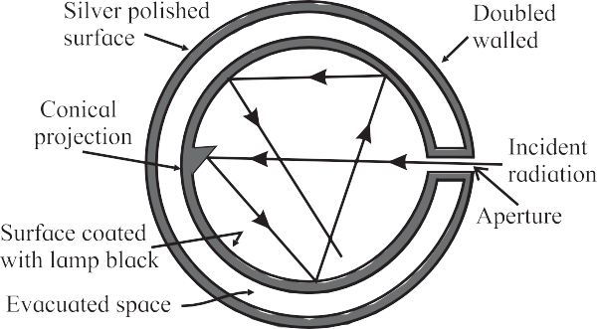
Ferry’s Blackbody
It consists of a double walled hollow sphere having tiny hole or aperture, through which radiant heat can enter.
The space between the walls is evacuated and outer surface of the sphere is silvered.
The inner surface of sphere is coated with lamp- black.
There is a conical projection on the inner surface of sphere opposite the aperture.
The projection ensures that a ray travelling along the axis of the aperture is not incident normally on the surface and is therefore not reflected back along the same path.
Radiation entering through the small hole has negligible chance of escaping back through the small hole
A heat ray entering the sphere through the aperture suffers multiple reflections and is almost completely absorbed inside

Slide 24

Emission of Heat Radiation
According to Pierre Prevost theory, all bodies at all temperatures above 0 K (absolute zero temperature) radiate thermal energy and at the same time, they absorb radiation received from the surroundings.
The amount of thermal radiation emitted per unit time depends on the nature of emitting surface, its area and its temperature.
The amount of heat radiated, Q, is directly proportional to the surface area (A) and time duration(t)
It is therefore convenient to consider the quantity of heat radiated per unit area per unit time
thus emissive power or radiant power ( R) of the body, at a given temperature T, is given by, R = $\frac{Q}{At}$
Dimensions of emissive power are [LoM1T-3] and SI unit is J m-2 s-1 or W/m2

Slide 25

Coefficient of Emission or Emissivity
The coefficient of emission or emissivity(e) of a given surface is the ratio of the emissive power ( R) of the surface to the emissive power ($R_{B}$) of a perfect black surface, at the same temperature.
e=$\frac{R}{R_{B}}$
For a perfect blackbody e = 1 , whereas for a perfect reflector e = 0.
Ordinary body radiate at a rate less then that of the blackbody at the same temperature.
Hence an ordinary body, 0 < e < 1 depending on the nature of the surface.
e.g., emissivity of copper is 0.3
Emissivity is larger for rough surfaces and smaller for smooth and polished surfaces.
Emissivity also varies with temperature and wavelength of radiation to some extent

Slide 26

Kirchhoff’s Law of Heat Radiation
It states that at a given temperature, the ratio of emissive power to coefficient of absorption of a body is equal to the emissive power of a perfect blackbody at the same temperature for all wavelengths. $\frac{R}{a}$ =$R_{B}$
Kirchhoff’s law can also be stated as follows: for a body emitting and absorbing thermal radiation in thermal equilibrium, the emissivity is equal to its absorptivity. Symbolically, a = e

Slide 27
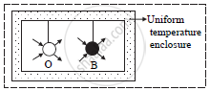

THEORETICAL PROOF OF Kirchhoff’s law
Consider an ordinary body O and a perfect blackbody B of identical geometric shapes placed in an enclosure.
In thermal equilibrium, both bodies will be at same temperature as that of the enclosure
Let R be the emissive power of body O, $R_{B}$ be the emissive power of blackbody B and a be the coefficient of absorption of body O.
If Q is the quantity of radiant heat incident on each body in unit time and $Q_{o}$ is the quantity of radiant heat absorbed by the body O, then $Q_{o}$ = a Q
As the temperatures of the body A and blackbody B remain the same, both must emit the same amount as they absorb in unit time. i.e. Quantity of radiant heat absorbed by body O= Quantity of heat emitted by body O
a Q = R -------------------- (1)

Slide 28

For the perfect blackbody B,
Q = $R_{B}$ --------- (2)
from (1) and (2)
a $R_{B}$= R
$∴$ $\frac{R}{a}$ = $R_{B}$ => $\frac{R}{R_{B}}$ = a
but $\frac{R}{R_{B}}$ = e => a = e

Slide 29
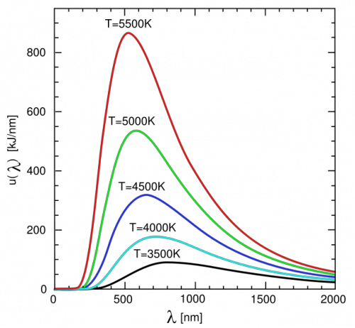
Spectral Distribution of Blackbody Radiation
Lummer and Pringsheim studied the energy distribution of blackbody radiation as a function of wavelength.
They kept the source of radiation (such as a cavity radiator) at different temperatures and measured the radiant power corresponding to different wavelengths.
Experimental observations indicated that the spectral distribution depended only on the absolute temperature T of a blackbody and was independent of the material.

Slide 30

From experimental curves, it is observed that,
at a given temperature, the energy is not uniformly distributed in the spectrum (i.e., as a function of wavelength) of blackbody,
at a given temperature, the radiant power emitted initially increases with increase of wavelength, reaches it’s maximum and then decreases. The wavelength corresponding to the radiation of maximum intensity, $λ_{max}$ , is characteristic of the temperature of the radiating body. (Remember, it is not the maximum wavelength emitted by the object),
area under the curve represents total energy emitted per unit time per unit area by the blackbody at all wavelengths,
the peak of the curves shifts towards the left – towards shorter wavelengths, i.e., the value of $λ_{max}$ decreases with increase in temperature,
at higher temperatures, the radiant power or total energy emitted per unit time per unit area (i.e., the area under the curve) corresponding to all the wavelengths increases,
at a temperature of 300 K (around room temperature), the most intense of these waves has a wavelength of about 5 × 10-6 m; the radiant power is smaller for wavelengths different from this value. Practically all the radiant energy at this temperature is carried by waves longer than those corresponding to red light. These are infrared radiations.

Slide 31
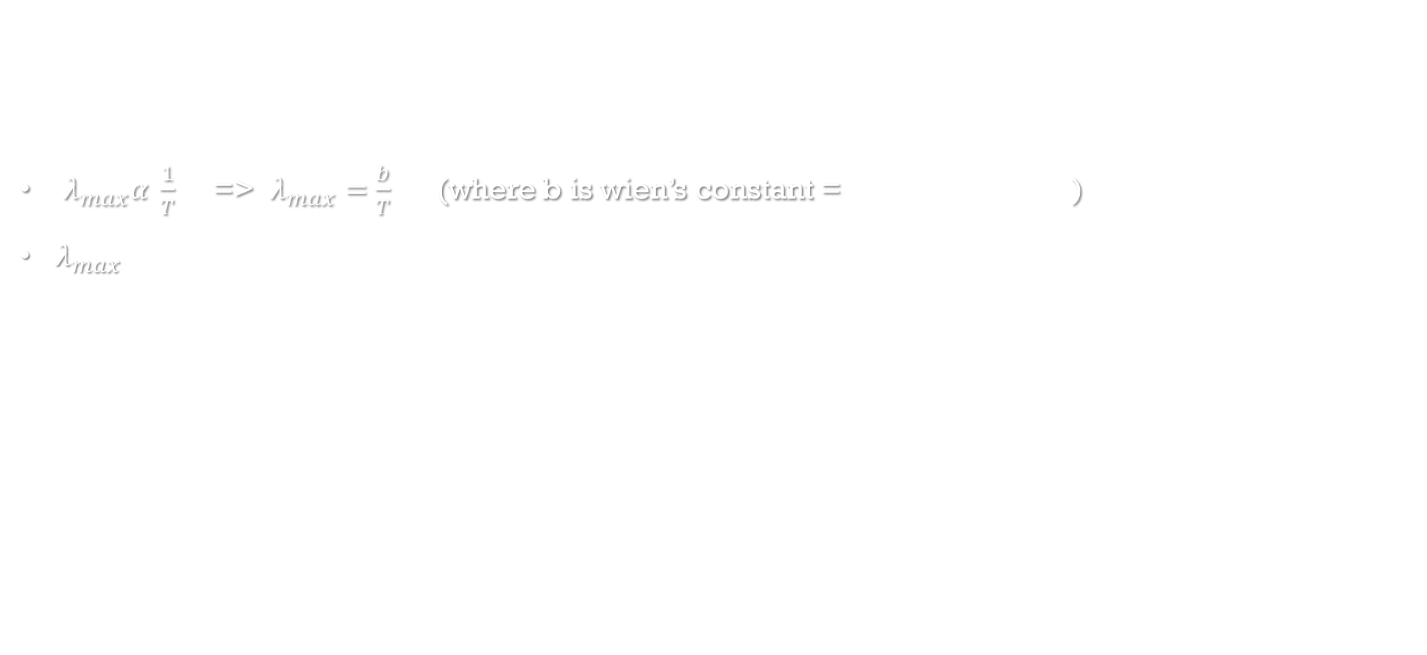
Wien’s Displacement Law
It is observed that the wavelength, for which emissive power of a blackbody is maximum, is inversely proportional to the absolute temperature of the blackbody. This is Wien’s displacement law
$λ_{max}α \frac{1}{T}$ => $λ_{max}=\frac{b}{T}$ (where b is wien’s constant =2.897 ´ 10-3 m K )
$λ_{max}$ indicates the wavelength at which the blackbody dominantly radiates.
Thus, it corresponds to the dominant colour of the radiating body and is a function of its temperature
This law is useful to determine temperatures of distant stars, Sun, moon etc.

Slide 32

Stefan-Boltzmann Law of Radiation
According to this law, “The rate of emission of radiant energy per unit area or the power radiated per unit area of a perfect blackbody is directly proportional to the fourth power of its absolute temperature”.
$R_{B}∝T^{4} ⇒R_{B}=σT^{4} (where σ is stefan^{′}s constant=\text{5.67 × }{10}^{−8} \text{J} {\text{m}}^{\text{−2}} s^{−1}K^{−4})$
Thus, the power radiated by a perfect blackbody depends only on its temperature and not on any other characteristics such as colour, materials, nature of surface etc.
If Q is the amount of radiant energy emitted in time t by a perfect blackbody of surface area A at temperature T, then $\frac{Q}{At}$ = $σT^{4}$
For ordinary body $\frac{Q}{At}$ = e$σT^{4}$ or R= e$σT^{4}$
If the perfect blackbody having absolute temperature T is kept in a surrounding which is at a lower absolute temperature $T_{o}$ , then the energy radiated per unit area per unit time ($R_{B}$) = $σT^{4}$
Energy absorbed from surroundings per unit area per unit time = $σT_{o}^{4}$
Therefore net loss of energy by perfect blackbody per unit area per unit time = $σT^{4}$- $σT_{o}^{4}$ = $σ(T^{4}$- $T_{o}^{4}$)
For an ordinary body, net loss of energy per unit area per unit time = $eσ(T^{4}$- $T_{o}^{4}$)
If temperature of surrounding is more than temperature of body then $eσ(T^{4}$- $T_{o}^{4}$) will be net gain.

